Slide 1


Quasi-Elastic Neutron Scattering (QENS) …
… what can high energy resolution neutron spectroscopy tell us?
Mark Telling
mark.telling@stfc.ac.uk

Slide 2


QENS : Learning Goals
Upon completion of this module, and subsequent
guided analysis of real experimental QENS data, you will be able to:
  describe the energy, time and length scales accessible using the QENS method
  visualise the neutron scattering cross section and the ensuing benefit of isotope labelling
  differentiate between coherent / incoherent scattering
  distinguish between different QENS instrument classes
  extract diffusion coefficients, activation energies, transition temperatures and geometries of motion

Slide 3
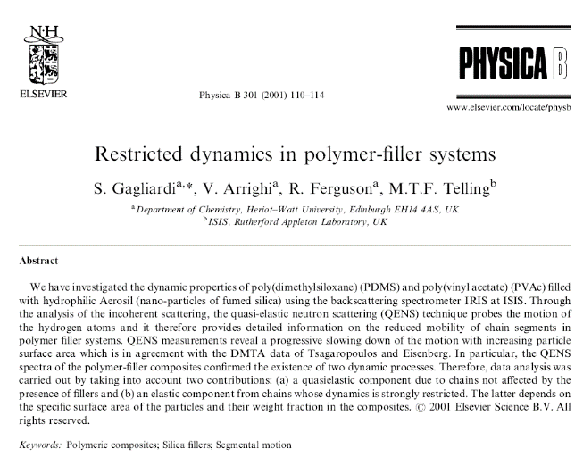
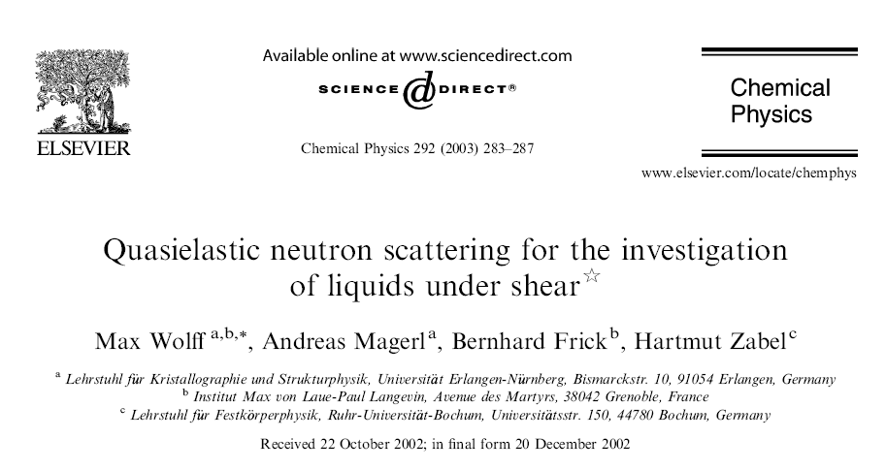
So … why investigate dynamics ?
“by understanding the microscopic dynamics we can tune a materials bulk properties”

Slide 4
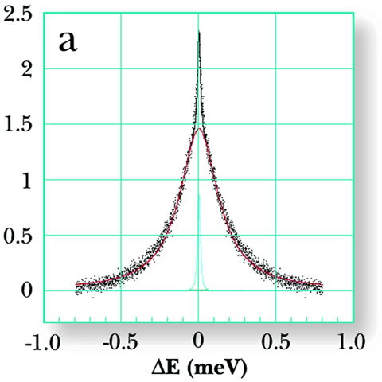
So … what is QENS ?
QENS : Quasi-Elastic Neutron Scattering
  well established neutron method
  Quasi-Elastic Neutron Scattering, M. Bée, 1988, ISBN-10: 0852743718
Tailored to measure low-energy (< 2 meV) excitations
  atomic or molecular excitations ‘diffusive’ in origin
Experimental dataset : peak of intensity, I, and width, Γ
  model the peak’s breadth as a function of T, P, composition to extract parameters linked to macromolecular movement
  intensity can exhibit marked angular variation which can give information about the geometry of the motion observed

Slide 5
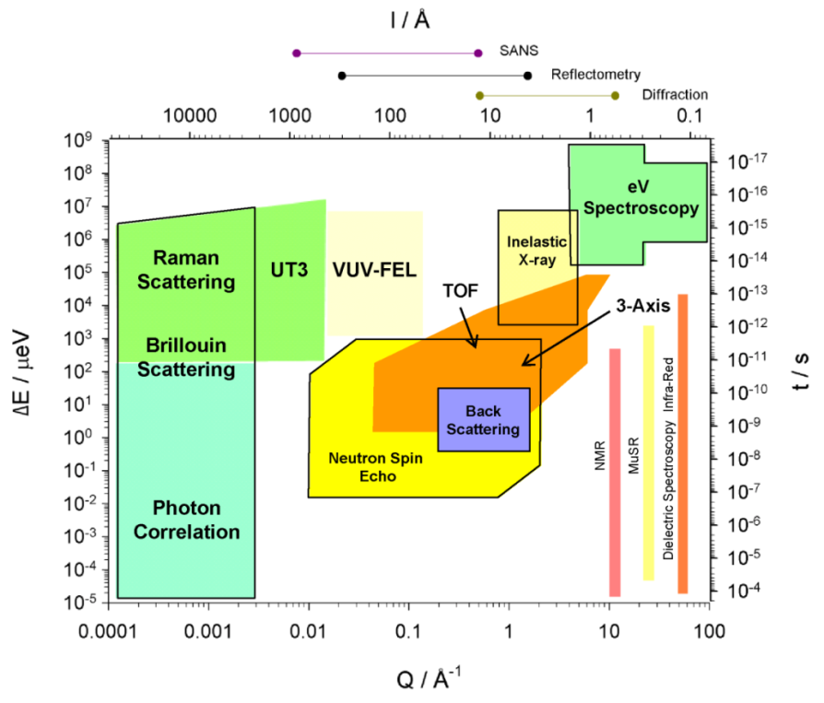
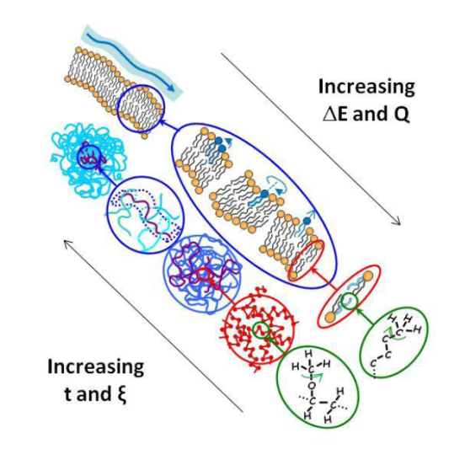
QENS: spatial and temporal landscape

Slide 6

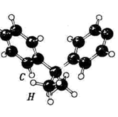
QENS and the Time of Flight (ToF) technique
Detector 1, Intensity(θ₁,E_{s})
E_{scattered}
Detector 2,
Intensity(θ₂,E_{s})
velocity selector
θ₁
distance, L₂
E_{incident}
θ₂
Neutron Source
distance, L₁

Slide 7
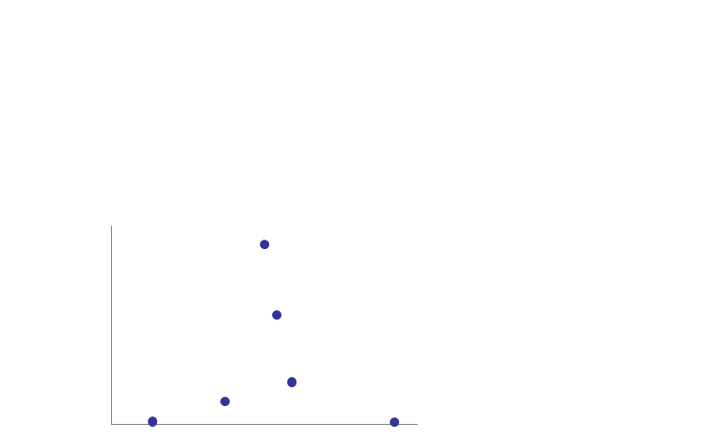
Lets heat things up …
Detector 1, Intensity(θ₁,E_{s})
E_{scattered}
Detector 2,
Intensity(θ₂,E_{s})
velocity selector
θ₁
distance, L₂
E_{incident}
θ₂
Neutron Source
distance, L₁
E_{i} = E_{s :} elastic scattering
Detected Intensity
Detected Intensity
time of arrival at detector
time of arrival at detector

Slide 8
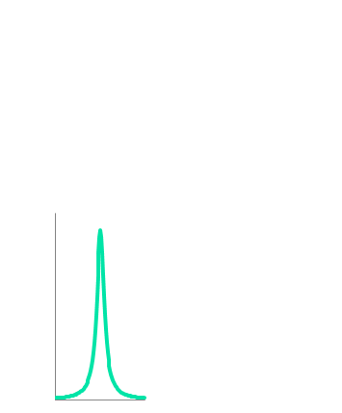

Lets heat things up …
Detector 1, Intensity(θ₁,ΔE)
E_{scattered}
Detector 2,
Intensity(θ₂,ΔE)
velocity selector
θ₁
distance, L₂
E_{incident}
θ₂
Neutron Source
distance, L₁
E_{i} = E_{s :} elastic scattering
Signal from
immobile material
Detected Intensity
Detected Intensity
FFT
mobile material
ΔE (energy transferred) = 0
ΔE
neutron instruments can see motions that occur on the pico-second to nano-second time scale

Slide 9
Lets heat things up …
Detector 1, Intensity(θ₁,ΔE)
E_{scattered}
Detector 2,
Intensity(θ₂,ΔE)
velocity selector
θ₁
distance, L₂
E_{incident}
θ₂
Neutron Source
distance, L₁
E_{i} = E_{s :} elastic scattering
Signal from
immobile material
1
Detected Intensity
Detected Intensity
FFT
mobile material
0
ΔE (energy transferred) = 0
ΔE
sample relaxation time, t
neutron instruments can see motions that occur on the pico-second to nano-second time scale

Slide 10
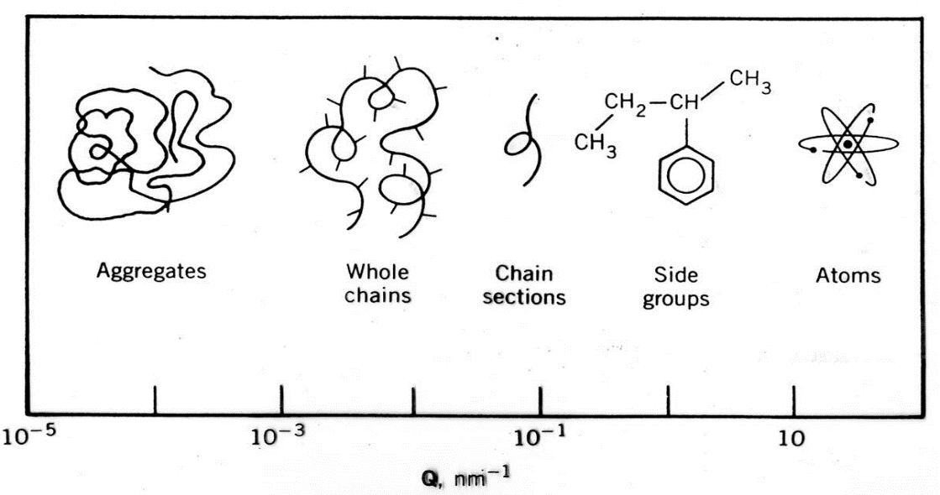
QENS and the Time of Flight (ToF) technique
Detector 1, Intensity(Q₁,ΔE)
Note!
E_{scattered}
Detector 2,
Intensity(Q₂,ΔE)
Scattering Angle, θ
is related to the momentum transfer
vector, Q, by…
velocity selector
θ₁
distance, L₂
i
E_{incident}
θ₂
Q_{ki=kf} = 4π(λ⁻¹)sin(θ/2)
Neutron Source
…which, when we relate this to Braggs law
is inversely proportional
to the length scale being observed
distance, L₁
i
θ ∝ Q ∝ 1/length scale
Light,
ultra low x-rays
SANS, SAXS
Wide angle, intermediate angle
Increasing scattering Angle, θ or Q

Slide 11
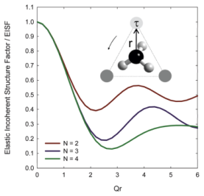
Information extracted …
Detector 1, Intensity(Q₁,ΔE)
E_{scattered}
Detector 2,
Intensity(Q₂,ΔE)
velocity selector
θ₁
distance, L₂
E_{incident}
θ₂
Neutron Source
Dynamics
distance, L₁
Geometry
1
I_{non-el}
I(Q,t)
neutron instruments see motion(s) that occur on the pico-second to nano-second time scale
I_{elastic}
0
sample relaxation time, t

Slide 12
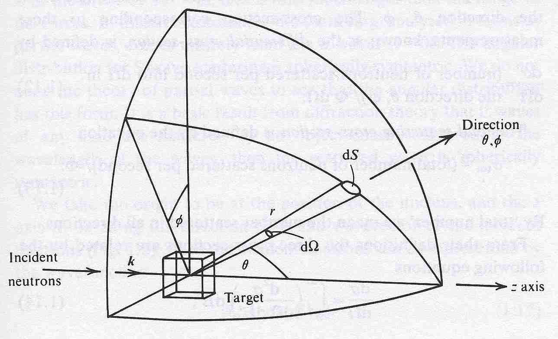
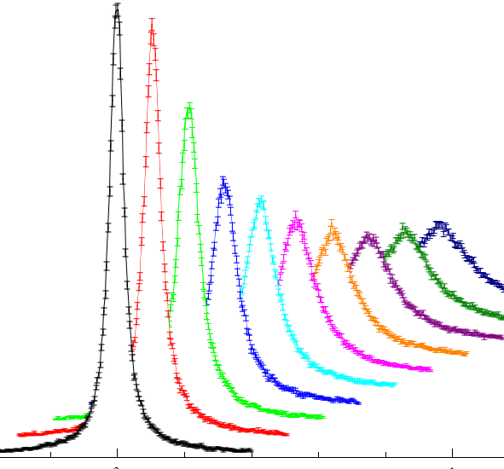
The Scattering Function : S(Q,ω)
We don’t just have one detector collecting data, but many. The intensity and/or breath of the peaks measured in different detectors can vary.
Now, the signal measured in any detector is a measurement of the double differential cross section
“…the probability that a neutron of incident energy E_{i} is scattered with into a solid angle element dΩ about the direction Ω and with a change of energy between E=ħω=E_{f} – E_{i} and ħ(ω+dω)”
Ultimately, scientists want to measure ‘something’ directly related to the sample alone which he/she can fit/model …
Scattering Function: S(Q,ω)
… it so happens that this ‘probability’ is dependent on how the neutron interacts with a sample; and this interaction in Q and E is unique to the specific macromolecule studied
Ι
θ, |Q|
ΔΕ = 0

Slide 13
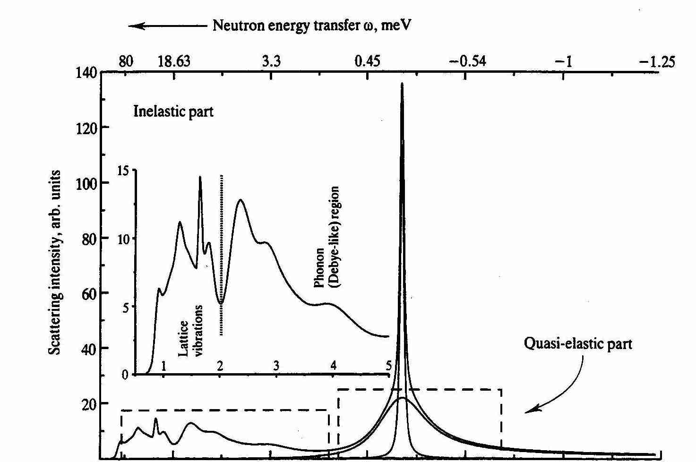
In reality …
In reality …
Intrinsic broadening around the ΔE = 0 positions is due to ‘instrument’ effects.
Defines the sensitivity, or resolution, of the instrument
= instrument contribution
ΔE = 0

Slide 14
Do all atoms scatter neutrons equally?
No!
While, for x-rays, the scattering strength is proportional to Z
The power to scatter neutrons varies randomly across the periodic table
Amplitude of scattered wave is dependent on the neutron – nucleus interaction, b (known as the scattering length)
b effectively dictates the strength of the neutron – nucleus interaction
In practice, we speak of the neutron-nucleus interaction in terms of area
Scattering cross section: σ = 4πb ²
This effective area related to the probability that there will be a interaction

Slide 15
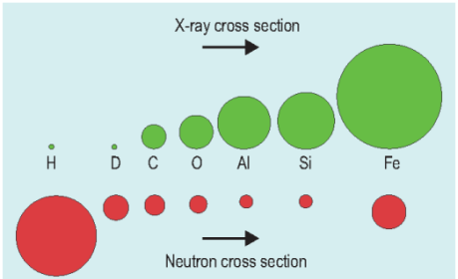
Do all atoms scatter neutrons equally?
No!
While, for x-rays, the scattering strength is proportional to Z
The power to scatter neutrons varies randomly across the periodic table

Slide 16
The scattering power of hydrogen …
Element | Scattering xs | Absorption xs
¹H | 82.03 | 0.3326
²H | 7.64 | 0.000519
Li | 1.37 | 70.5
C | 5.551 | 0.0035
O | 4.232 | 0.00019
Na | 3.28 | 0.53
S | 1.026 | 0.53
Cross-sections in units of area known as the barn (b) = 10⁻²⁴ cm²

Slide 17
The scattering power of hydrogen …
Element | Scattering xs | Absorption xs
¹H | 82.03 | 0.3326
²H | 7.64 | 0.000519
Li | 1.37 | 70.5
C | 5.551 | 0.0035
O | 4.232 | 0.00019
Na | 3.28 | 0.53
S | 1.026 | 0.53
Cross-sections in units of area known as the barn (b) = 10⁻²⁴ cm²

Slide 18
The scattering power of hydrogen …
Element | Scattering xs | Absorption xs
¹H | 82.03 | 0.3326
²H | 7.64 | 0.000519
⁷Li | 1.4 | 0.04
C | 5.551 | 0.0035
O | 4.232 | 0.00019
Na | 3.28 | 0.53
S | 1.026 | 0.53
Cross-sections in units of area known as the barn (b) = 10⁻²⁴ cm²

Slide 19
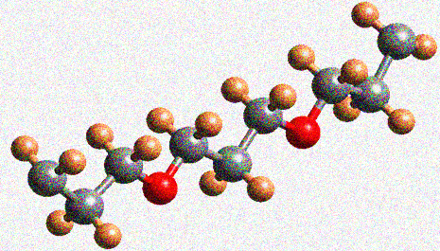
Why is this advantageous ?
hydrogen
carbon
oxygen

Slide 20
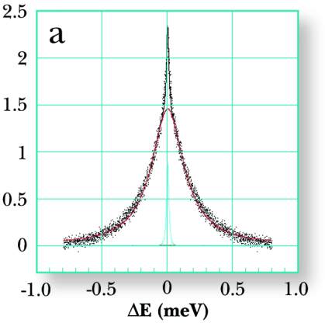
Selective deuteration
Element | Scatter | Abs
¹H | 82.03 | 0.3326
²H | 7.64 | 0.000519
Li | 1.37 | 70.5
C | 5.551 | 0.0035
O | 4.232 | 0.00019
Na | 3.28 | 0.53
S | 1.026 | 0.53
total measured neutron intensity is dominated by signal from the H atoms
hydrogen
carbon
oxygen

Slide 21
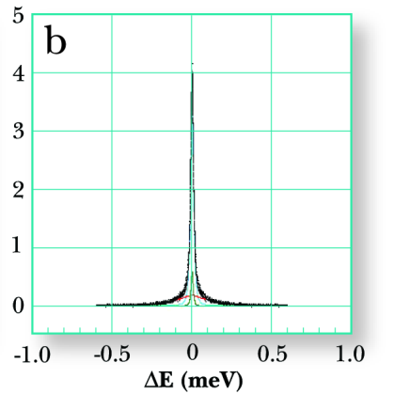
Selective deuteration
D
Element | Scatter | Abs
¹H | 82.03 | 0.3326
²H | 7.64 | 0.000519
Li | 1.37 | 70.5
C | 5.551 | 0.0035
O | 4.232 | 0.00019
Na | 3.28 | 0.53
S | 1.026 | 0.53
D
D
D
D
D
D
D
D
D
D
D
D
D
D
D
D
D
Detected Intensity
spectral contribution from H atom position is greatly reduced
D
deuterium
carbon
oxygen

Slide 22
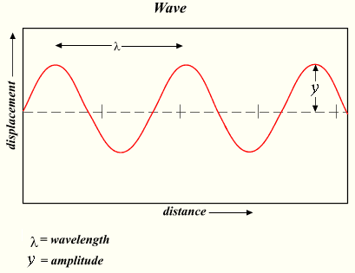
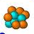
Coherent and Incoherent Scattering …
Perfect crystal with i nuclei all of scattering length, b
At Bragg condition - constructive
λ (∼d)
θ
θ
d
Away from Bragg condition - destructive
extra distance bottom wave has to travel compared to top wave to remain IN PHASE = 2d(sinθ) (aka Bragg’s Law)

Slide 23

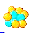
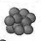
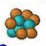
Coherent and Incoherent Scattering …
Perfect crystal with i nuclei, most with b but also some isotopes with b’
At Bragg condition
θ
θ
d
Away from Bragg condition
d
extra distance bottom wave has to travel compared to top wave to remain IN PHASE = 2d(sinθ) (aka Bragg’s Law)

Slide 24
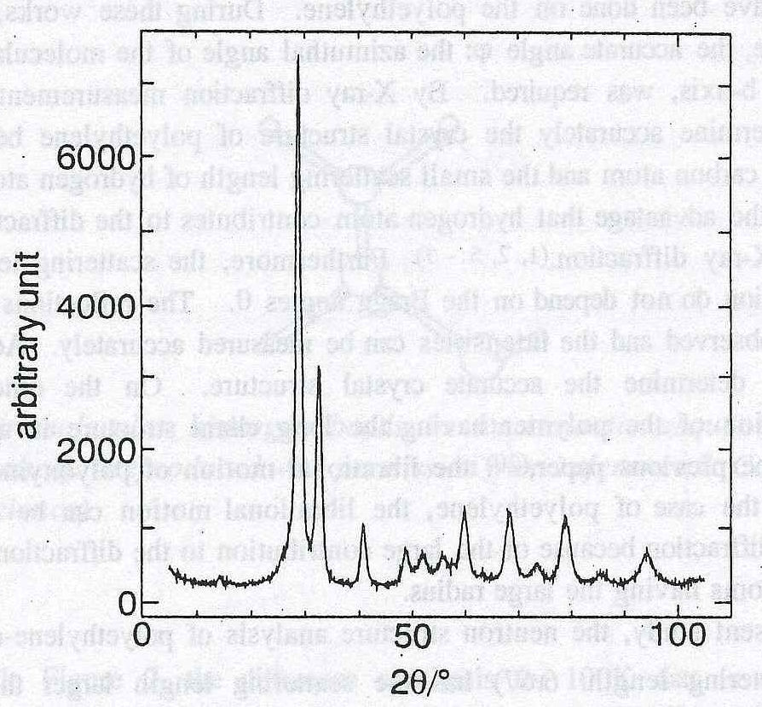
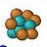
Coherent and Incoherent Scattering …
Perfect crystal with i nuclei, most with b but also some isotopes with b’
θ
θ
d
d
extra distance bottom wave has to travel compared to top wave to remain IN PHASE = 2d(sinθ) (aka Bragg’s Law)
Crystalline Polyethylene (Y. Takahashi)

Slide 25
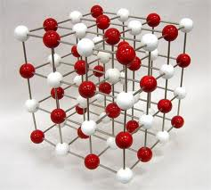
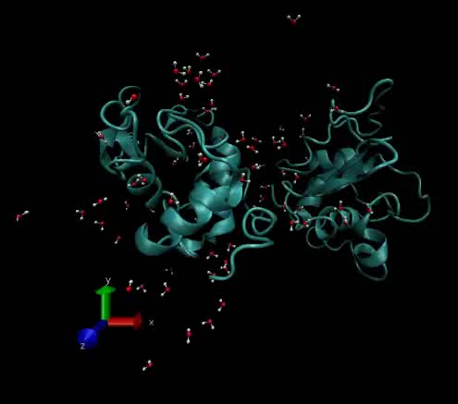
Coherent vs Incoherent Scattering …
So how do these two types modify the detected intensity …
… because we now have a system of i species with a mean scattering length, <b_{i}>, and a root mean deviation from this mean, √(<b_{i}²>-<b_{i}>²), our total scattering cross section, σ = 4πb², can be written …
Coherent
In-coherent
… such that our measured intensity …
… comprised of both coherent and incoherent signals
Van Hove L. Correlations in Space and Time and Born Approximation Scattering Phys Rev 1954; 95: 249-262.

Slide 26
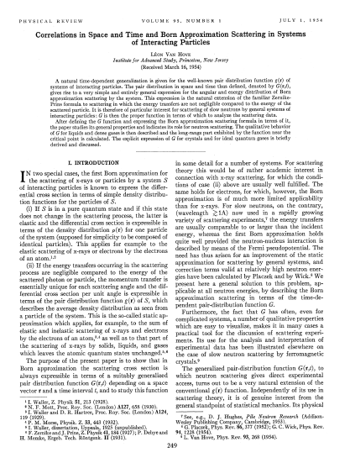
Coherent vs Incoherent Scattering …
So what do these two types of scattering tell us …
Coherent
describes correlations between different atoms at different times
In-coherent
describes correlations between
the position of a single atom at
different times
Van Hove L. Correlations in Space and Time and Born Approximation Scattering Phys Rev 1954; 95: 249-262.

Slide 27
So … what information can we extract ?

Slide 28
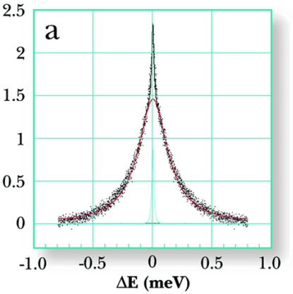
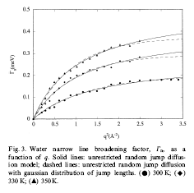
Line Width Analysis : activation energies, D

Slide 29
Geometry : Elastic Incoherent Structure Factor

Slide 30
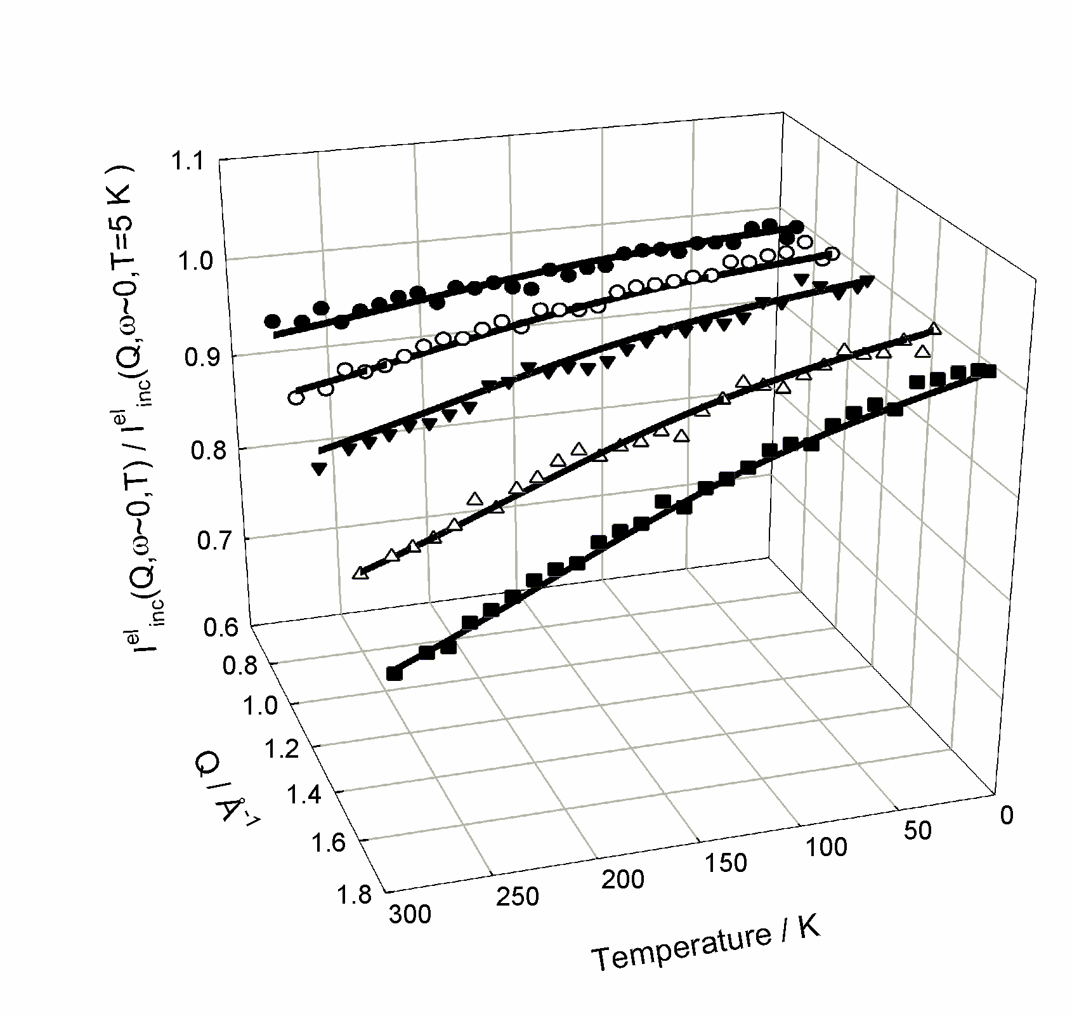
Elastic Window Scans : transitions and ‘rigidity’
To determine transition temperatures
  plot neutron intensity at the ΔE = 0 position vs. temperature
  deviations from linearity suggest a transition
To determine the mean squared displacement (msd) parameter, <r²>, from Elastic Window plots
  Plot neutron intensity (@ ΔE=0) vs. temperature vs. Q
  Fit:
T_{g}
=

Slide 31
QENS Instrumentation
Energy Transfer, ΔE = E_{incident} – E_{final}
Therefore, to determine ΔE we need to define E_{i} OR E_{f}

Slide 32
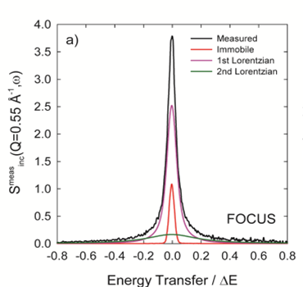
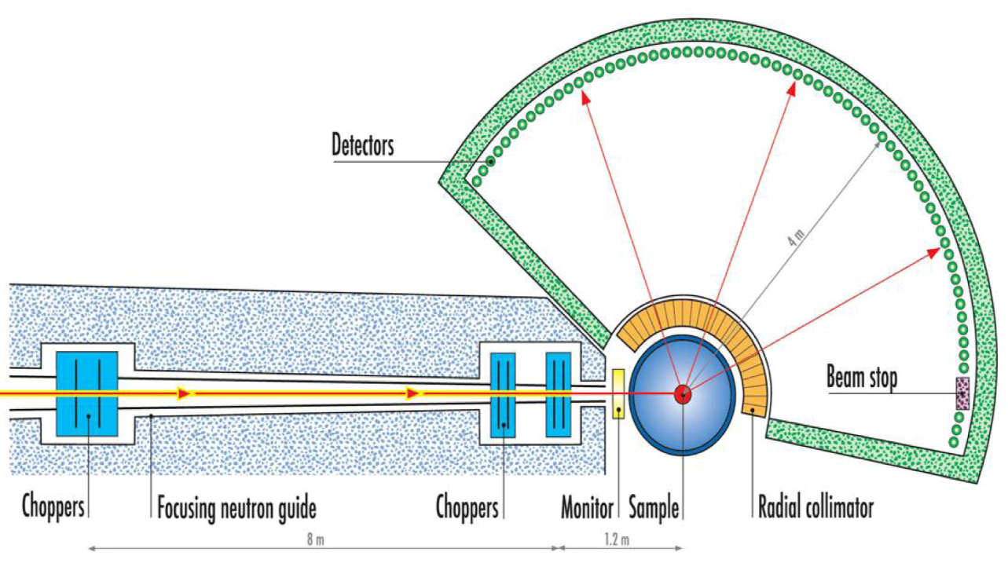
Instrumentation : direct geometry
Energy Transfer, ΔE = E_{incident} – E_{final}
defines E_{i}
probes: mostly local motion(s)
τ : pico-second
length scale : 1 - 30 Å
mostly incoherent signal
measure : S(Q,ω)
signal in detector
http://www.ill.eu/instruments-support/instruments-groups/instruments/in5

Slide 33
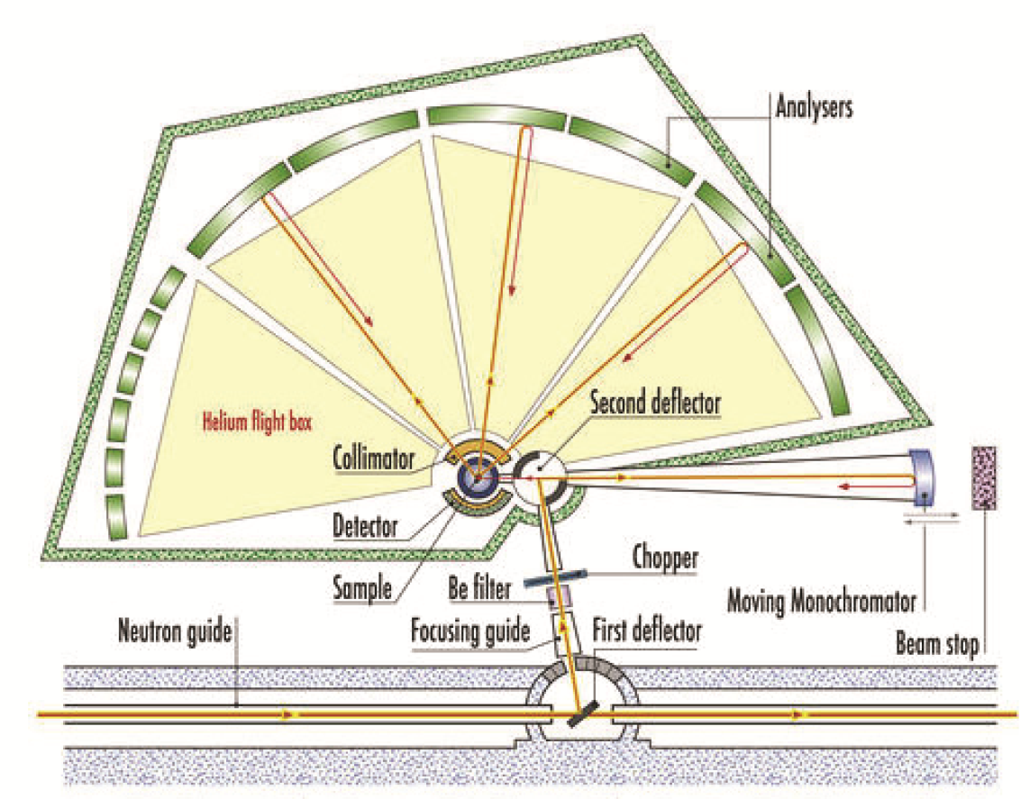
Instrumentation : indirect geometry
Energy Transfer, ΔE = E_{incident} – E_{final}
defines E_{f}
probes: mostly local motion(s)
τ : pico- to nano-second
length scale : 1 - 30 Å
mostly incoherent signal
measure : S(Q,ω)
signal in detector
http://www.ill.eu/instruments-support/instruments-groups/instruments/in16

Slide 34

Instrumentation : neutron spin echo
However, we can also use a spin polarised beam …
broadband
examines: mostly collective motion(s)
τ : nano-second
length scale : comparable to SANS
mostly coherent signal
measure : I(Q,t)
signal in detector
http://www.ill.eu/instruments-support/instruments-groups/instruments/in11

Slide 35
Putting it all together …
Notes:
Origin of the term “scattering cross-section”
The scattering cross-section expresses the probability that a particle will be scattered as it transverses a given thickness of matter dx. Classically, σ = πd² is a target area that each molecule presents to the oncoming particles. This target area is a cross-section of the region within which a collision can take place, as viewed along the direction of motion of the beam.
see also Appendix 1

Slide 36
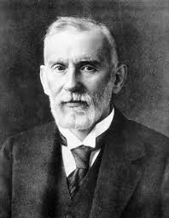

Paul Ehrlich and the ‘magic bullet’ concept
‘a drug which can be transported to a specific organ within the body and released at a controlled rate without affecting surrounding organisms’
Notes:
Having been responsible for a neutron instrument dedicated to problems at the physics – life science interface I have had the privilege to work on many bio-physics problems from the point of view of neutron scattering. For example
The behaviour of cytoplasmic water
Bio-protective characteristics of trehalose
Controlled assembly in water of large proteins into high performance silk fibres
36

Slide 37
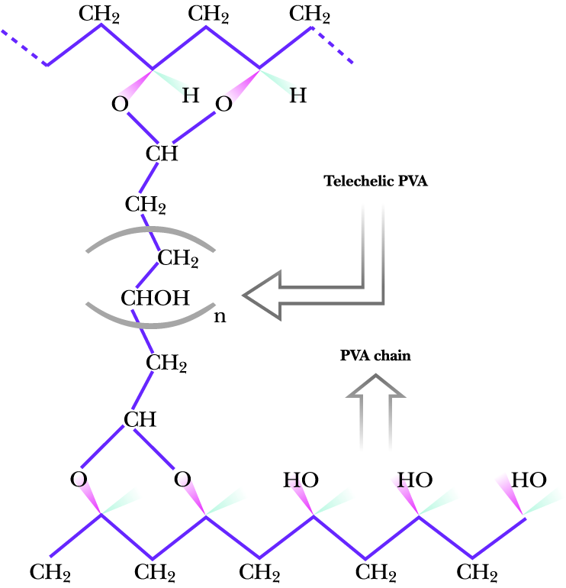
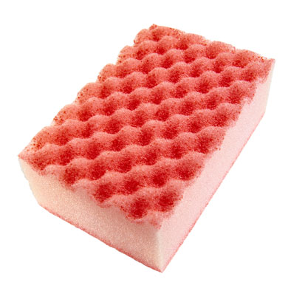

‘magic bullets’ and plastic sponges
drug delivery system
  hydrogel-based micro spheres
retains water up to 99 % its weight
responds to environmental stimuli
proposed application
  contain bioactive drug in solution in gel pores
basic drug delivery requirements
  biocompatibility, good solvent diffusivity
key to development is understanding gel behaviour
  characterise the polymer mobility vs cross links, chemical and physical nature of cross links, hydrophobicity, investigate how gel behaviour intertwined with movement of confined water
By cross linking poly (vinyl alcohol) chains a
‘polymer sponge’ is formed
Notes:
Origin of the term “scattering cross-section”
The scattering cross-section expresses the probability that a particle will be scattered as it transverses a given thickness of matter dx. Classically, σ = πd² is a target area that each molecule presents to the oncoming particles. This target area is a cross-section of the region within which a collision can take place, as viewed along the direction of motion of the beam.
see also Appendix 1

Slide 38
‘magic bullets’ and plastic sponges
initial interest
  characterise the raw hydrogel material
focus
  rationalise how structural features influence diffusive properties of solvent
material to be used
  poly (vinyl alcohol) (PVA)
why PVA ?
a) bio-compatible
b) used in surgery as thread for stitches
c) thermally stable and acid tolerant
By cross linking poly (vinyl alcohol) chains a
‘polymer sponge’ is formed
Notes:
Origin of the term “scattering cross-section”
The scattering cross-section expresses the probability that a particle will be scattered as it transverses a given thickness of matter dx. Classically, σ = πd² is a target area that each molecule presents to the oncoming particles. This target area is a cross-section of the region within which a collision can take place, as viewed along the direction of motion of the beam.
see also Appendix 1

Slide 39
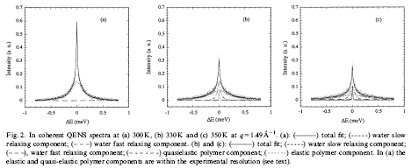
‘magic bullets’ and plastic sponges
Hydrogel and H₂O
T = 10 ºC 25 ºC 30 ºC
Notes:
Origin of the term “scattering cross-section”
The scattering cross-section expresses the probability that a particle will be scattered as it transverses a given thickness of matter dx. Classically, σ = πd² is a target area that each molecule presents to the oncoming particles. This target area is a cross-section of the region within which a collision can take place, as viewed along the direction of motion of the beam.
see also Appendix 1

Slide 40
‘magic bullets’ and plastic sponges
Hydrogel and H₂O
T = 10 ºC 25 ºC 30 ºC
Notes:
Origin of the term “scattering cross-section”
The scattering cross-section expresses the probability that a particle will be scattered as it transverses a given thickness of matter dx. Classically, σ = πd² is a target area that each molecule presents to the oncoming particles. This target area is a cross-section of the region within which a collision can take place, as viewed along the direction of motion of the beam.
see also Appendix 1

Slide 41
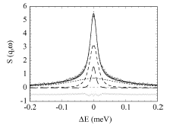
‘magic bullets’ and plastic sponges
Hydrogel and H₂O
Notes:
Origin of the term “scattering cross-section”
The scattering cross-section expresses the probability that a particle will be scattered as it transverses a given thickness of matter dx. Classically, σ = πd² is a target area that each molecule presents to the oncoming particles. This target area is a cross-section of the region within which a collision can take place, as viewed along the direction of motion of the beam.
see also Appendix 1

Slide 42
‘magic bullets’ and plastic sponges
Hydrogel and H₂O
Notes:
Origin of the term “scattering cross-section”
The scattering cross-section expresses the probability that a particle will be scattered as it transverses a given thickness of matter dx. Classically, σ = πd² is a target area that each molecule presents to the oncoming particles. This target area is a cross-section of the region within which a collision can take place, as viewed along the direction of motion of the beam.
see also Appendix 1

Slide 43

‘magic bullets’ and plastic sponges
Hydrogel and H₂O
Peak is made up of 3 components
polymer relaxation, Γ_{p}
water diffusive motion, Γ_{d}
water rotational motion, Γ_{r}
Notes:
Origin of the term “scattering cross-section”
The scattering cross-section expresses the probability that a particle will be scattered as it transverses a given thickness of matter dx. Classically, σ = πd² is a target area that each molecule presents to the oncoming particles. This target area is a cross-section of the region within which a collision can take place, as viewed along the direction of motion of the beam.
see also Appendix 1

Slide 44

‘magic bullets’ and plastic sponges
Hydrogel and H₂O vs. Hydrogel and D₂O
Polymer Segmental Relaxation
a) water (H₂O) b) deuterium (D₂O) confined in a PVA based hydrogel
Notes:
Origin of the term “scattering cross-section”
The scattering cross-section expresses the probability that a particle will be scattered as it transverses a given thickness of matter dx. Classically, σ = πd² is a target area that each molecule presents to the oncoming particles. This target area is a cross-section of the region within which a collision can take place, as viewed along the direction of motion of the beam.
see also Appendix 1

Slide 45

‘magic bullets’ and plastic sponges
Water dynamics
Fickian Diffusion Model
Random, Jump Diffusion
D = diffusion coefficient
τ_{o} = residence time
Notes:
Origin of the term “scattering cross-section”
The scattering cross-section expresses the probability that a particle will be scattered as it transverses a given thickness of matter dx. Classically, σ = πd² is a target area that each molecule presents to the oncoming particles. This target area is a cross-section of the region within which a collision can take place, as viewed along the direction of motion of the beam.
see also Appendix 1

Slide 46
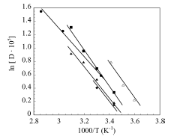
‘magic bullets’ and plastic sponges
Neutrons have helped us understand …
… how we can tune diffusivity
cross link dependent diffusion, D_{water}
… the nature of the water-polymer interaction
governed by hydrogen-bonding
… that diffusion is not continuous (Fick's Law)
… that the diffusion rate is Arrhenius :
D_{water} = D_{o}exp(-E_{a}/RT)
… that T = 290K, D_{water} is less than D_{bulk water}
super cooling effect
0.05
0.02
Bulk Water
0.1
Notes:
Origin of the term “scattering cross-section”
The scattering cross-section expresses the probability that a particle will be scattered as it transverses a given thickness of matter dx. Classically, σ = πd² is a target area that each molecule presents to the oncoming particles. This target area is a cross-section of the region within which a collision can take place, as viewed along the direction of motion of the beam.
see also Appendix 1

Slide 47
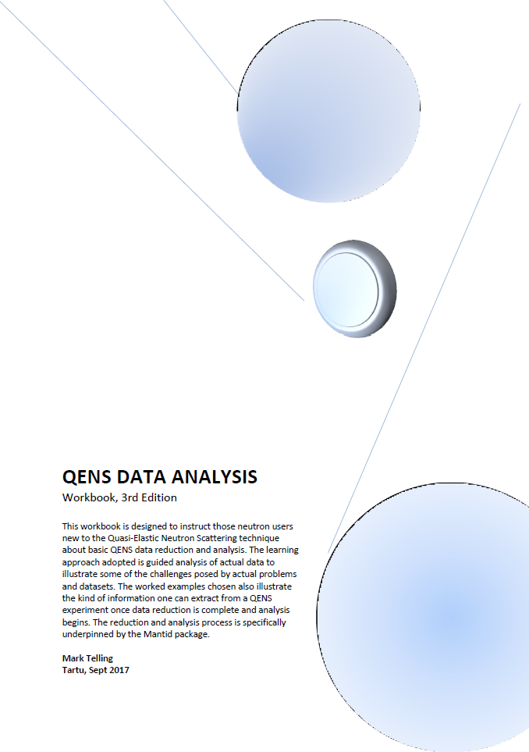
Tutorial : Guided Data Reduction and Analysis
  Using a guided ‘workbook’ approach the ideas presented in this lecture will be enforced by following standard raw data reduction and analysis procedures to:
  explore translational diffusion characteristics (water)
  explore rotational diffusion characteristics (protein)
  familiarise yourself issues faced when analysing QENS data
Analysis will be performed using the Mantid package
  the software platform adopted at ESS, ISIS, ILL and SNS
  workbook based on version 4.0.0
On the USB stick you should find:
  workbook
  all experimental data sets required
  supplementary data files
  further reading
Notes:
Having been responsible for a neutron instrument dedicated to problems at the physics – life science interface I have had the privilege to work on many bio-physics problems from the point of view of neutron scattering. For example
The behaviour of cytoplasmic water
Bio-protective characteristics of trehalose
Controlled assembly in water of large proteins into high performance silk fibres
47

Slide 48
Thank you!
e-mail: mark.telling@stfc.ac.uk

